Slide 1

Dativerse Keynote: Everyone Deserves a Voice
By Tracy Boggiano

Slide 2










Tracy Boggiano SQL Server DBA for 20+ years @TracyBoggiano databasesuperhero.com tracyboggiano
speakingmentors.com

Slide 3

DEI Virtual Group and Summit Panel Discussion
Was started before PASS folded
We are still alive @data_dei
Every other month having a speaker
Months between just having a get together
PASS Data Community Summit Panel Discussion DEI

Slide 4
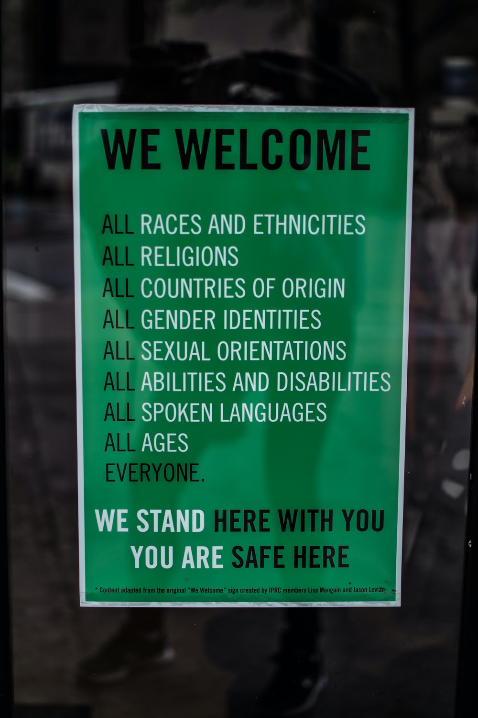
Diversity, Equity, and Inclusion
BIPOC
LGBTQ+
Women
Minorities
Neurodivergent people
Differently abled people

Slide 5
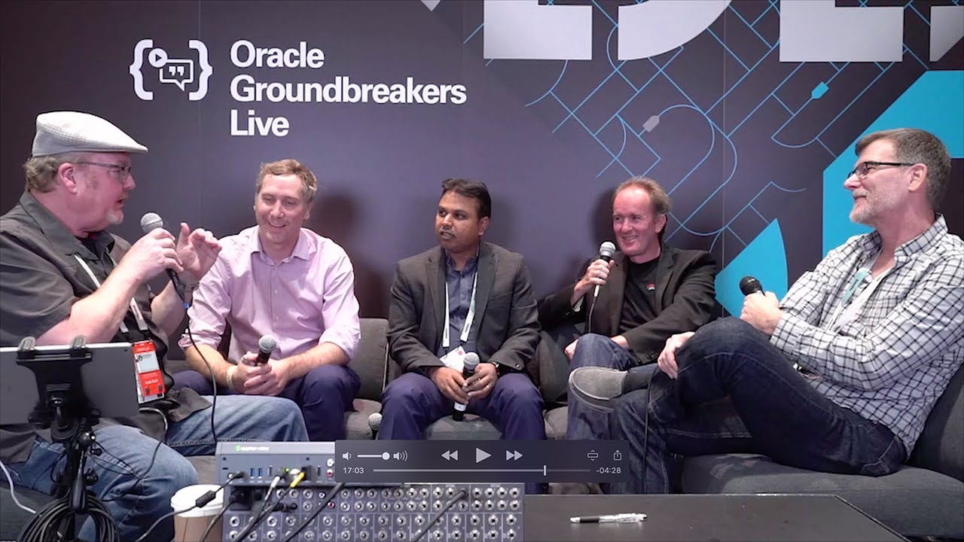

Slide 6

Be a Listener
Listening is one of the best communication skills we can develop
Listening shows respect

Slide 7

Be open-minded
Being open-minded means approaching topics or ideas that are unfamiliar to you or that you do not typically align to, with curiosity

Slide 8

Be willing to talk
Being open to conversations with others can provide us with lots of opportunities to develop friendships, learn something new, and support one another.

Slide 9

Be inclusive
Being inclusive creates a space for all people to feel they belong, which builds stronger friendships, helps everyone feel supported, and fosters mutual respect.

Slide 10

Don’t make assumptions
While it may be easy to make assumptions, don’t.
For example, don’t assume the sexual orientation or gender identity of your friends, coworkers, and community members.
Remember pay and intelligence are questioned, while disclination happens getting a job.

Slide 11

Use inclusive language
Using inclusive language is a conscious effort to communicate to ourselves and others in a way that is aligned with our values
Straight and cisgender people often don’t think about their pronouns and can tend to make assumptions about other people’s pronouns because they feel like they are obvious.

Slide 12

Confront your own prejudices and biases
As uncomfortable as it may feel to confront our own prejudices and biases.
Start with becoming self-aware.

Slide 13

Educate yourself
Once you have identified your prejudices and biases, begin educating yourself.

Slide 14

Treat all people with dignity and respect
Treat all people, regardless of their gender identity and/or sexual orientation, BIPOC, neurodivergence, disability, or race with dignity and respect.

Slide 15

Conclusion
Be a good ally by
Listening
Learn what you can by educating yourself
Learn from your mistakes and apologize
Make people in the #SQLFamily feel included and equal to their peers

Slide 16

Resources
22 Books to Challenge Your Assumptions About Diversity and Inclusion in the Workplace - https://medium.com/halloapp/22-books-to-challenges-your-assumptions-about-diversity-and-inclusion-in-the-workplace-d890d0cfa08f
All images are from unsplash.com.

